Slide 1
All pairs shortest path problem

Slide 2
Motivation
Solve an all-pairs shortest-paths problem by running a single-source shortest-paths algorithm |V| times, once for each vertex as the source.
  Dijkstra's algorithm
  linear-array implementation of the min-priority queue
  The binary min-heap implementation of the min-priority queue
  implement the min-priority queue with a Fibonacci heap
A better method to find shortest path?

Slide 3

Assumption
Use an adjacency-matrix representation
  input is an n × n matrix W representing the edge weights of an n-vertex directed graph G = (V, E).
  output of the all-pairs shortest-paths algorithms presented in this chapter is an n × n matrix D = (dij), where entry dij contains the weight of a shortest path from vertex i to vertex j.

Slide 4
Dynamic-programming algorithm based on matrix multiplication
The Floyd-Warshall algorithm

Slide 5
Shortest paths and matrix multiplication
Dynamic-programming algorithm
  1. Characterize the structure of an optimal solution.
  2. Recursively define the value of an optimal solution.
  3. Compute the value of an optimal solution in a bottom-up fashion.
  4. Constructing an optimal solution from computed information

Slide 6
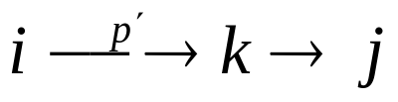
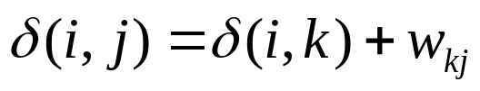
Observation of the structure of a shortest path
All subpaths of a shortest path are shortest paths (Lemma 24.1)
Consider a shortest path p from vertex i to vertex j, and suppose that p contains at most m edges.
If vertices i and j are distinct, then we decompose path p into , where path p′ now contains at most m-1 edges. By Lemma 24.1, p′ is a shortest path from i to k, and so

Slide 7
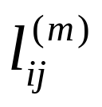
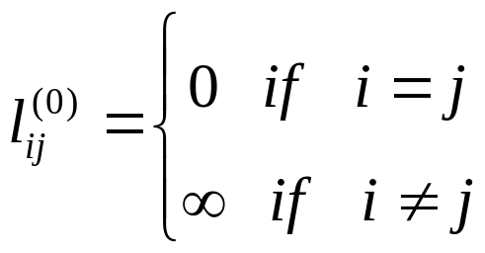
A recursive solution to the all-pairs shortest-paths problem
Let be the minimum weight of any path from vertex i to vertex j that contains at most m edges.
When m = 0, there is a shortest path from i to j with no edges if and only if i = j.

Slide 8

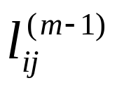
For , we compute as the minimum of
and the minimum weight of any path from i to j consisting of at most m edges, obtained by looking at all possible predecessors k of j.

Slide 9
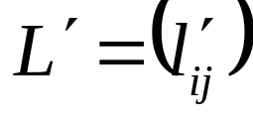
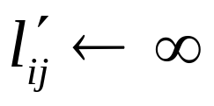
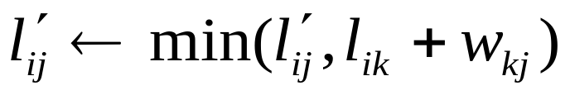

Computing the shortest-path weights bottom up
EXTEND-SHORTEST-PATHS(L, W)
1 n ← rows[L]
2 let be an n × n matrix
3 for i ← 1 to n
4 do for j ← 2 to n
5 do
6 for k ← 1 to n
7 do
8 return

Slide 10
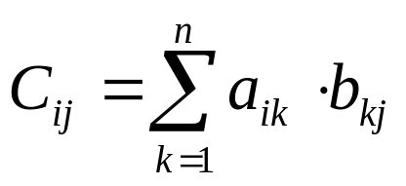
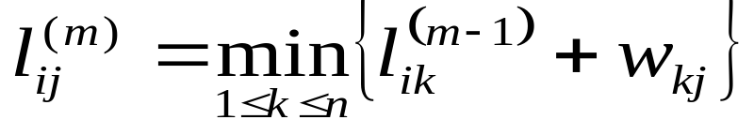
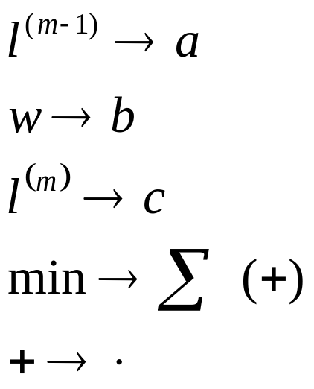
Relation with matrix multiplication
Compute the matrix product C = A · B of two n × n matrices A and B. Then, for i, j = 1, 2,..., n, we compute
If we make the substitutions in

Slide 11
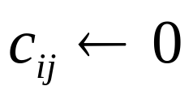
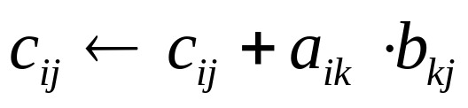
Relation with matrix multiplication
If we make these changes to EXTEND-SHORTEST-PATHS and also replace ∞ by 0, we obtain the straightforward Θ(n3)-time procedure for matrix multiplication:
MATRIX-MULTIPLY(A, B)
1 n ← rows[A]
2 let C be an n × n matrix
3 for i ← 1 to n
4 do for j ← 1 to n
5 do
6 for k ← 1 to n
7 do
8 return C

Slide 12
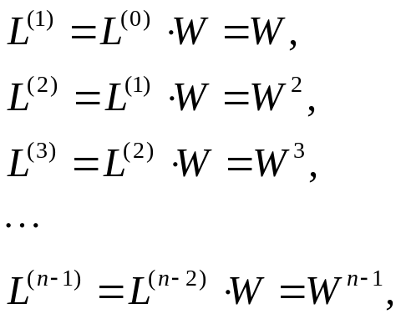

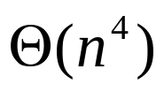
All-pairs shortest-paths problem
We compute the shortest-path weights by extending shortest paths edge by edge. Letting A · B denote the matrix "product" returned by EXTEND-SHORTEST-PATHS(A, B), we compute the sequence of n - 1 matrices
As we argued above, the matrix contains the shortest-path weights. The following procedure computes this sequence in time.

Slide 13



As we argued above, the matrix contains the shortest-path weights. The following procedure computes this sequence in time.
SLOW-ALL-PAIRS-SHORTEST-PATHS(W)
1 n ← rows[W]
2 L(1) ← W
3 for m ← 2 to n - 1
4 do ← EXTEND-SHORTEST-PATHS( , W)
5 return

Slide 14
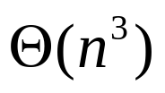
The Floyd-Warshall algorithm
Use different dynamic-programming formulation to solve the all-pairs shortest-paths problem on a directed graph G = (V, E). The resulting algorithm, known as the Floyd-Warshall algorithm, runs in time.
The algorithm considers the "intermediate" vertices of a shortest path

Slide 15
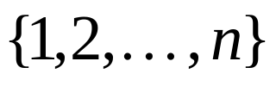
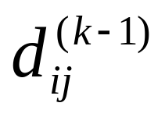
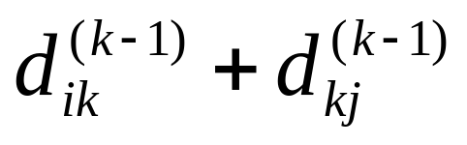
The structure of a shortest path
Observation 1: A shortest path does not contain the same vertex twice.
  Proof: A path containing the same vertex twice contains a cycle. Removing cycle gives a shorter path.
Observation 2: For a shortest path from to such that any intermediate vertices on the path are chosen from the set , there are two possibilities:
1. k is not a vertex on the path,
The shortest such path has length
2. k is a vertex on the path.
The shortest such path has length
Notes:
where an intermediate vertex of a simple path p = v1, v2,..., vl is any vertex of p other than v1 or vl, that is, any vertex in the set {v2, v3,..., vl-1}.

Slide 16
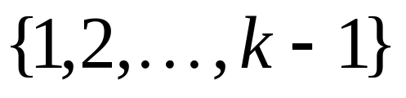
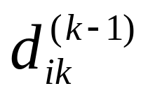
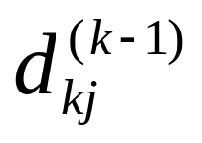
The structure of a shortest path
Consider a shortest path from i to j containing the vertex k. It consists of a subpath from i to k and a subpath from k to j.
Each subpath can only contain intermediate vertices in , and must be as short as possible, namely they have lengths and
Hence the path has length
Notes:
where an intermediate vertex of a simple path p = v1, v2,..., vl is any vertex of p other than v1 or vl, that is, any vertex in the set {v2, v3,..., vl-1}.

Slide 17
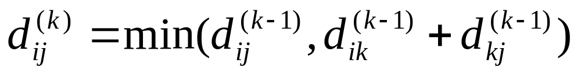
Combining the two cases we get

Slide 18
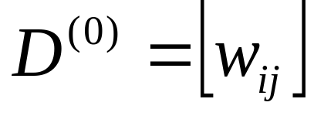
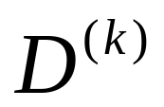
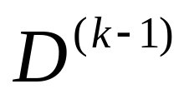
The Bottom-up Computation
Bottom: , the weight matrix.
Compute from using
for k = 1, …, n

Slide 19
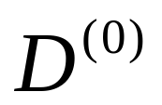
Floyd-Warshall Algorithm
FLOYD-WARSHALL(W)
1 n ← rows[W]
2 ← W
3 for k ← 1 to n
4 do for i ← 1 to n
5 do for j ← 1 to n
6 do
7 return D(n)

Slide 20

Quiz
  Run Floyd-Warshall algorithm for the following graph:

Slide 21
Conclusion
Dijkstra’s algorithm.
  Nearly linear-time when weights are nonnegative.
Acyclic edge-weighted digraphs.
  Faster than Dijkstra’s algorithm.
  Negative weights are no problem.
Negative weights and negative cycles.
  If no negative cycles, can find shortest paths via Bellman-Ford.
  If negative cycles, can find one via Bellman-Ford.
All-pair shortest path.
  can be solved via Floyd-Warshall
  Floyd-Warshall can also compute the transitive closure of directed graph.

